Slide 1
Themes And Epics Module
Main Project Presentation – Team 3
Cohort Code : QEA21QE021

Slide 2
Main ProjectTeam
S.No | Employee Name | Employee ID
1 | Parshyam Nagaveni | 918628
2 | Chandra Kavya | 919339
3 | Shravika Ingole | 918890
4 | Gintena Saitharun Goud | 919352
5 | Vunnam Gowtham | 918630

Slide 3
Project Description
To validate themes and epics module in main spring .

Slide 4
Tools, Software, Website Used
Website : https://pratesting.cognizant.com
Selenium : Portable Framework for testing web applications and automating the process.
Java : High level programming language.
Eclipse : Integrated Development environment for various Programming Languages.
TestNG : Open source testing framework.
Maven : Software and project management tool.
POM : Object Repository design pattern.

Slide 5
Work Done
The code is written in JAVA language and then it is further automated using selenium.
Page Object Model(POM) is used to reduce the code duplication for various instances.
Input data is taken from excel file to fill the fields in themes and epic module using Apache POI.
A common repository git has been used for ease to work.

Slide 6
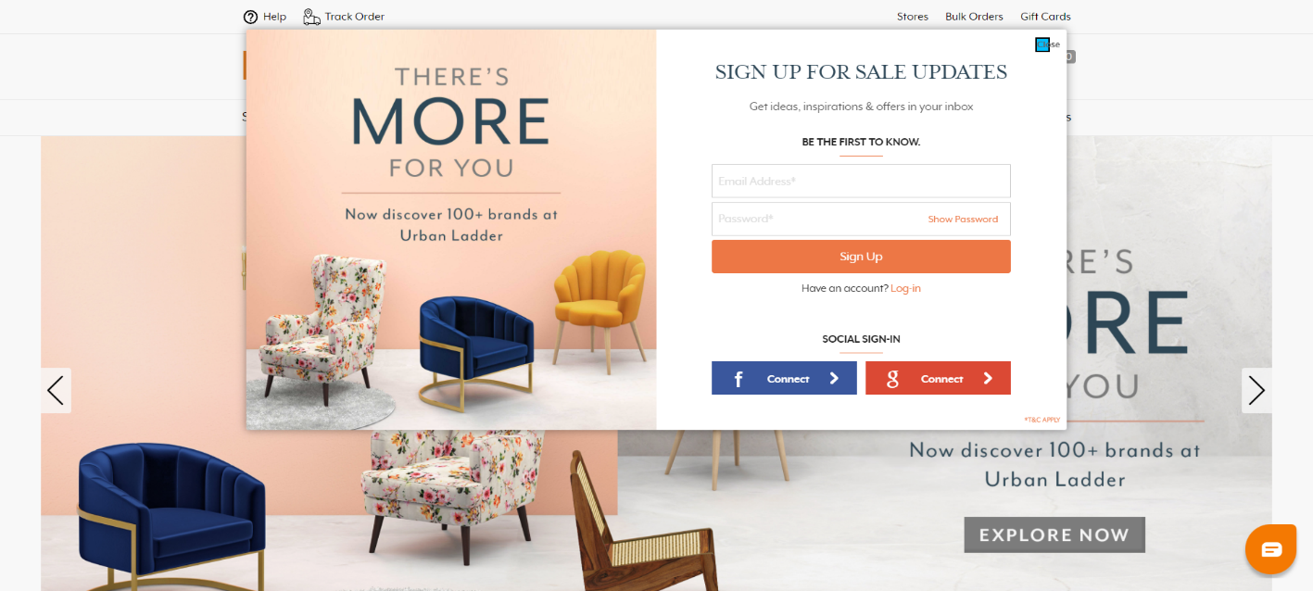
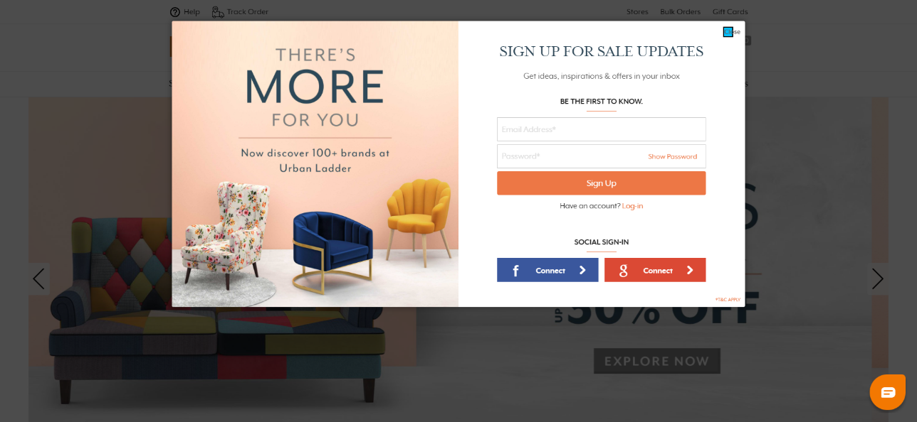
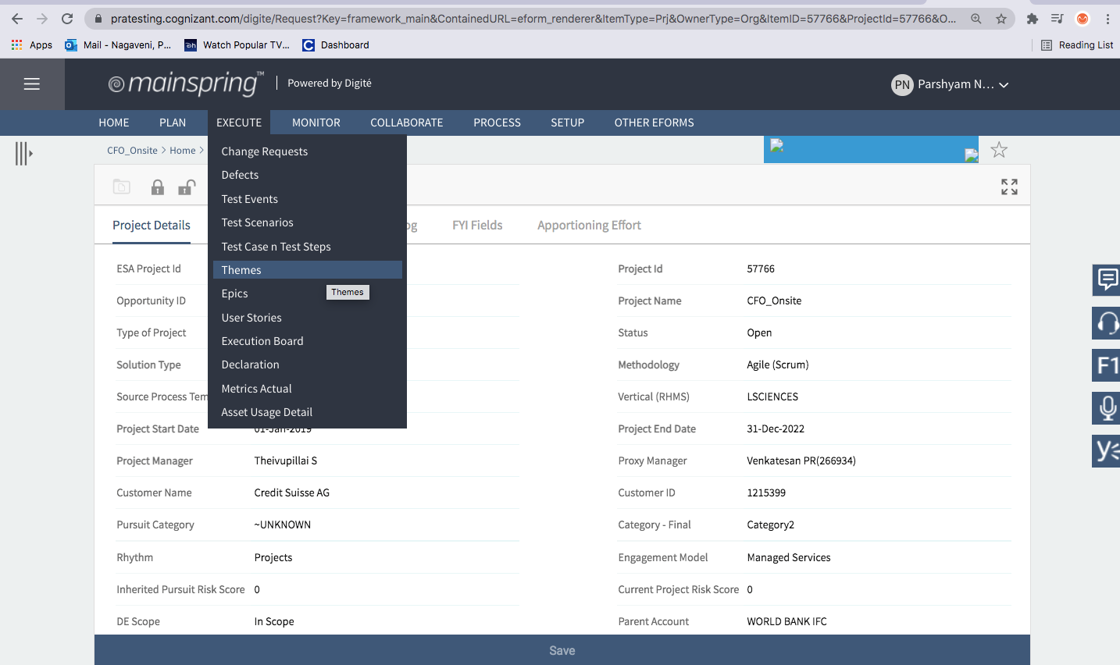
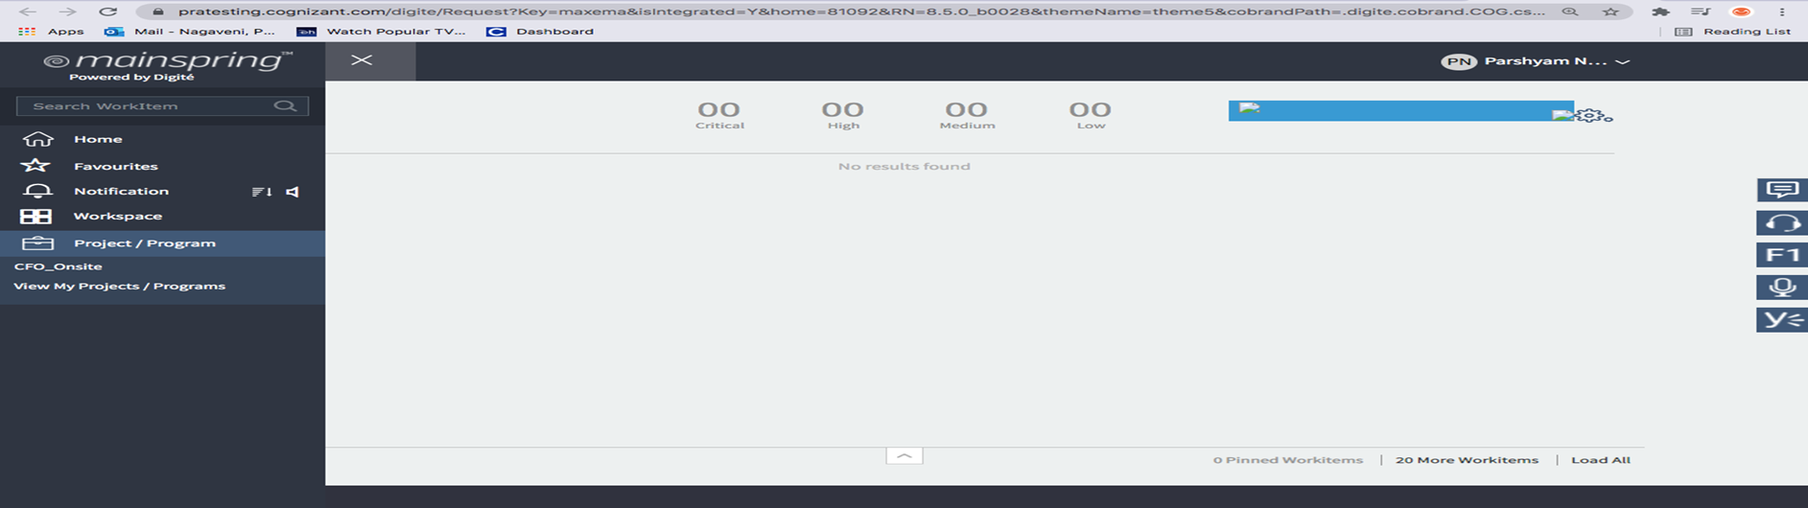
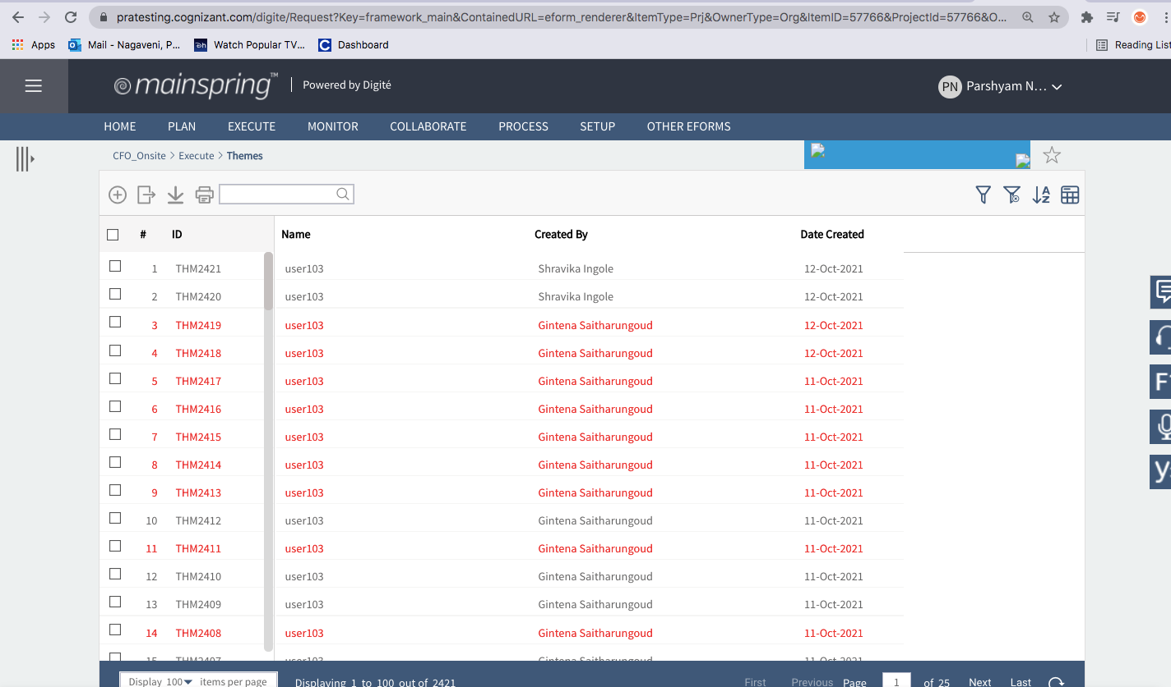
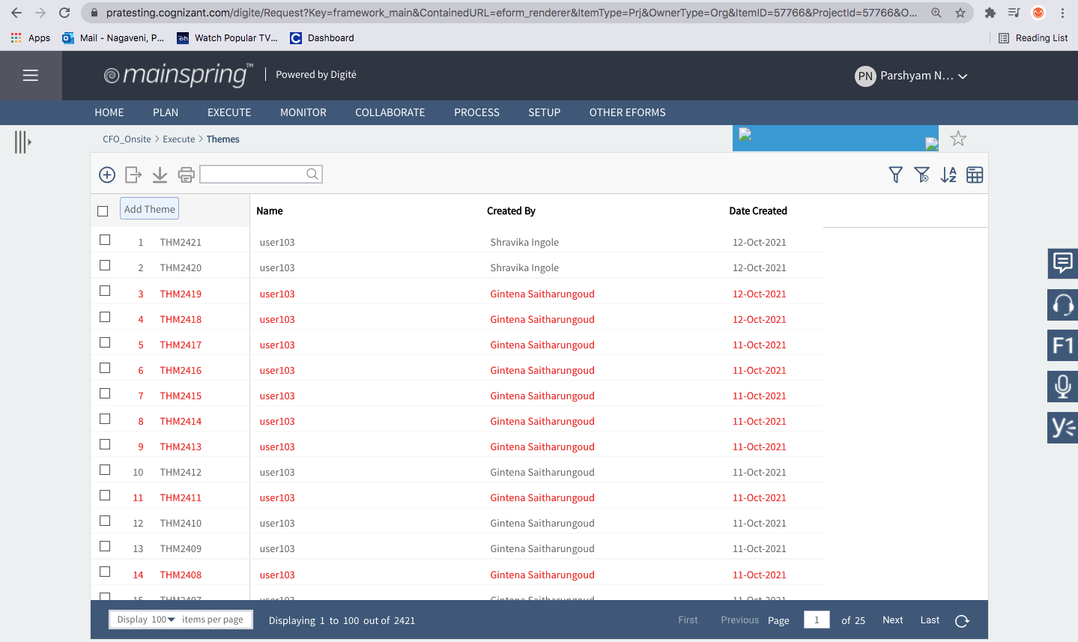
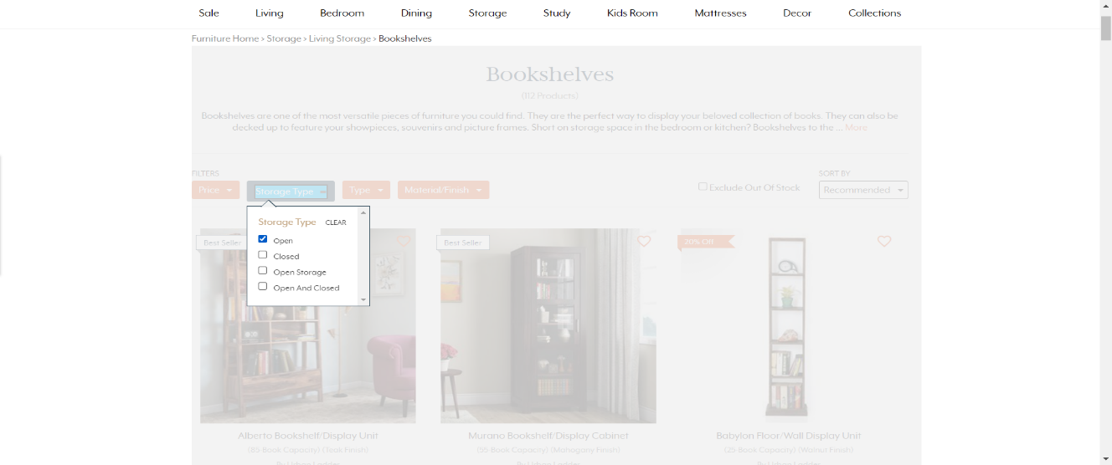
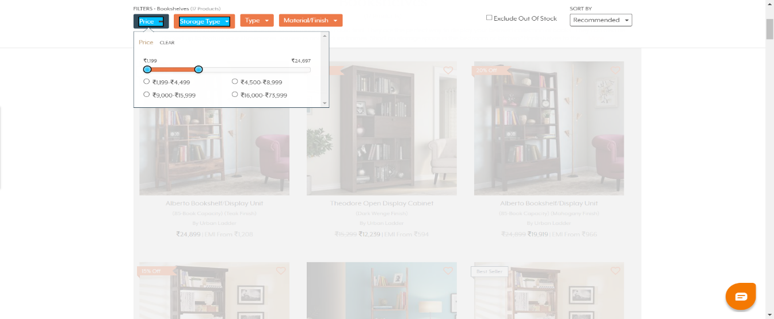
Screenshots of Output

Slide 7
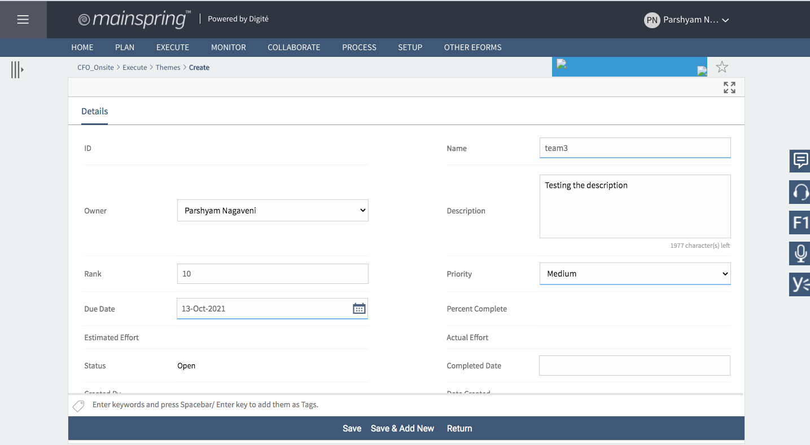
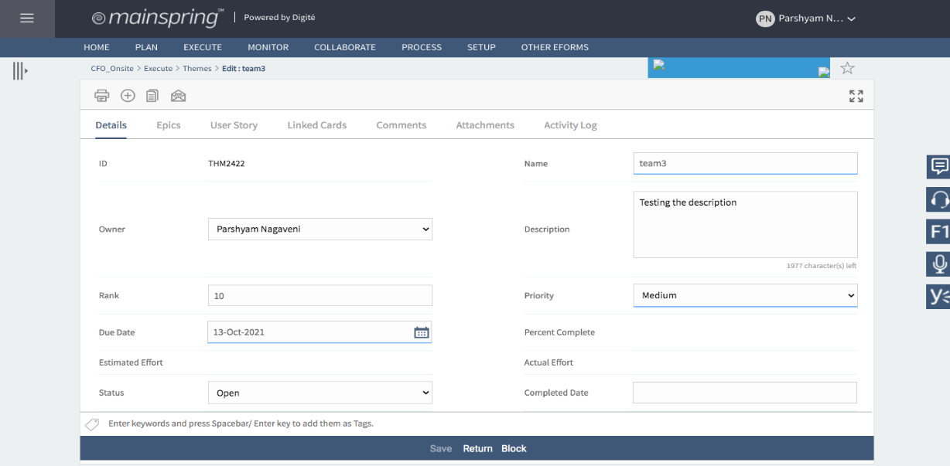
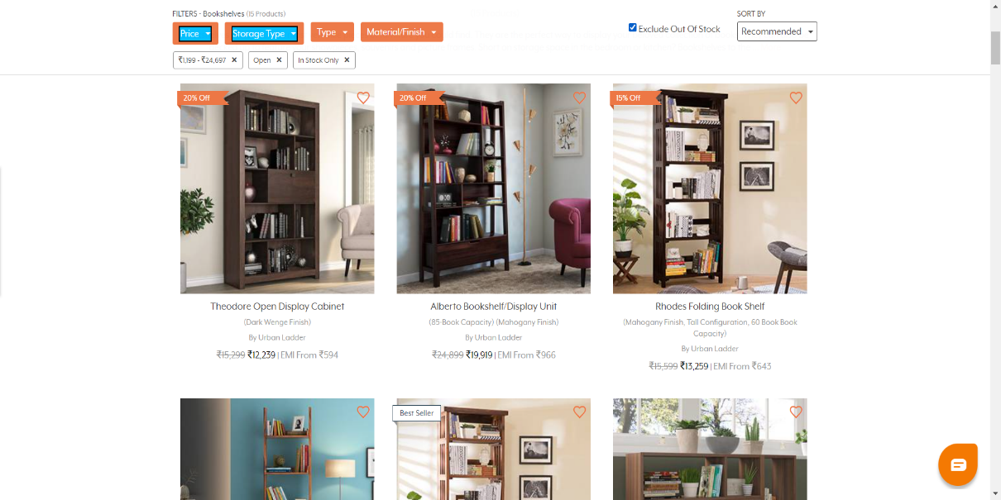
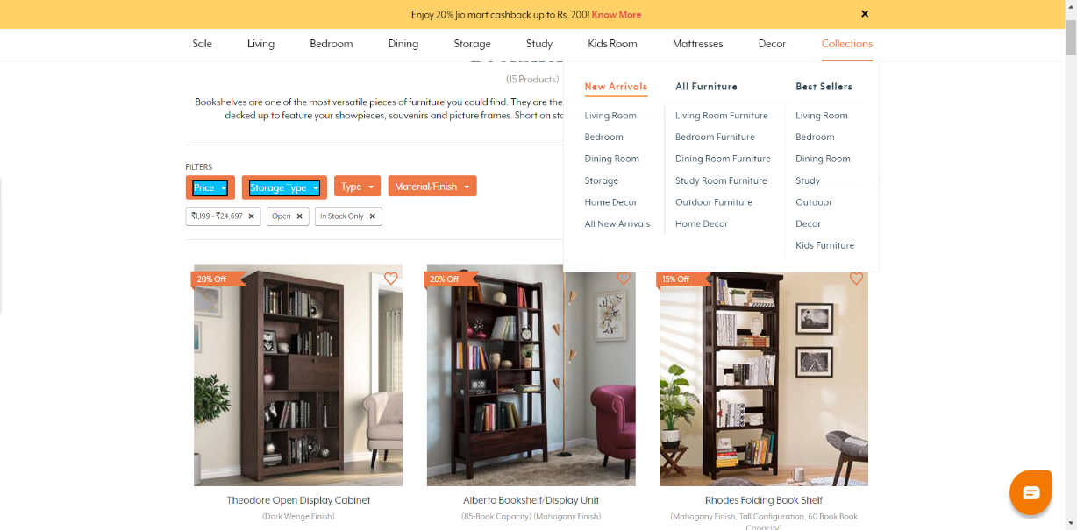
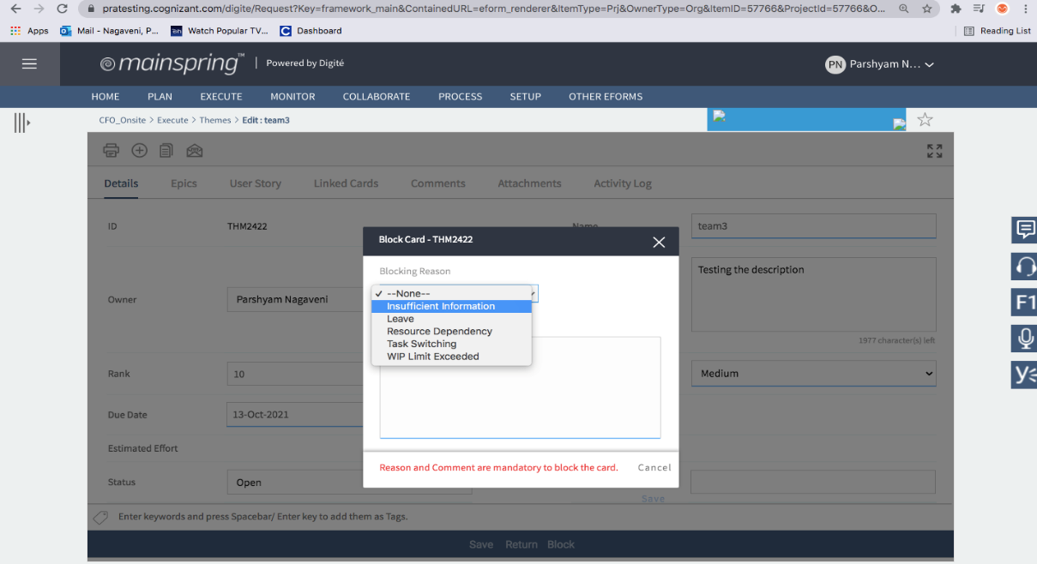
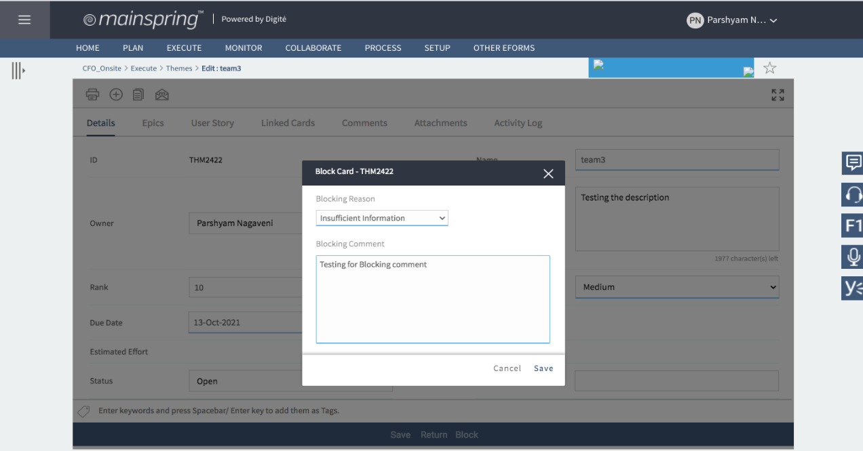
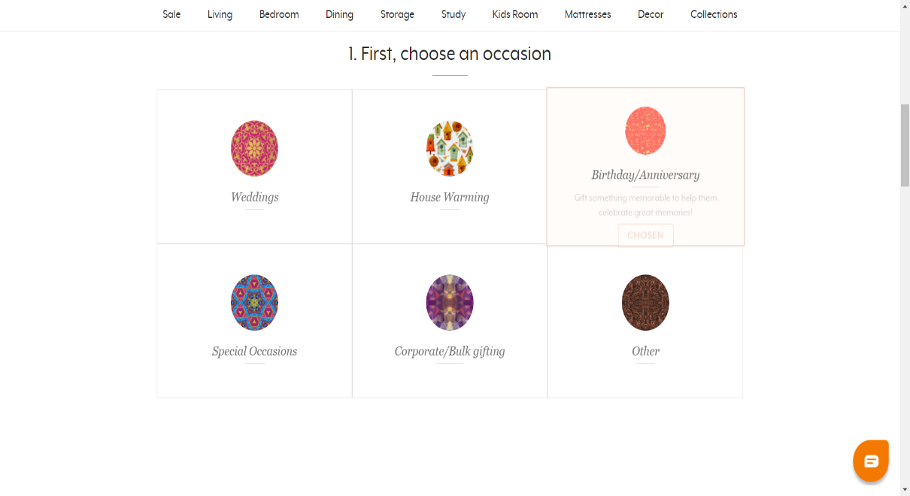
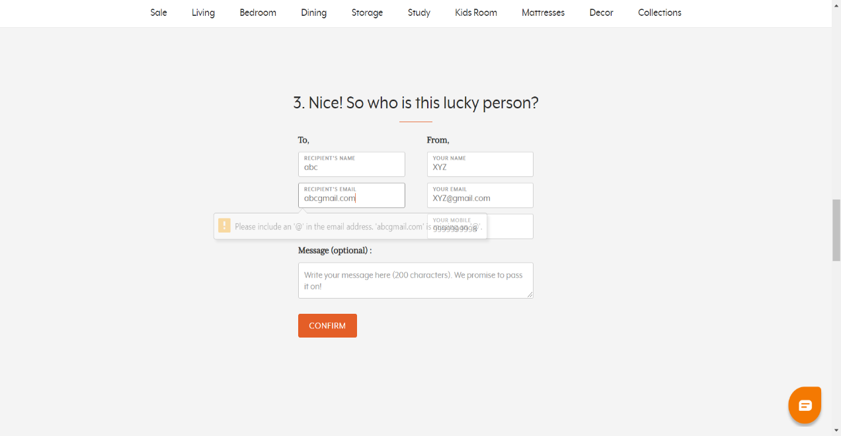
Screenshots of Output

Slide 8
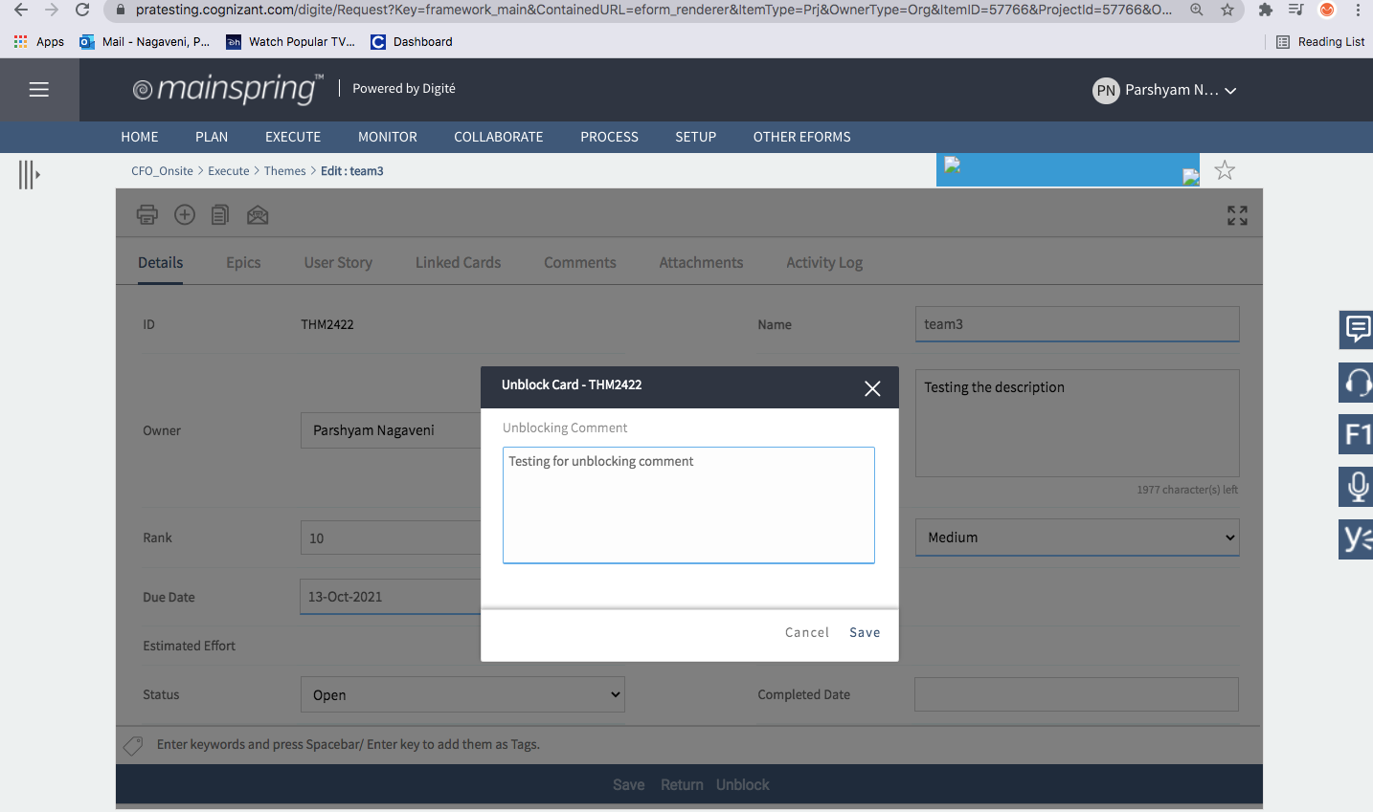
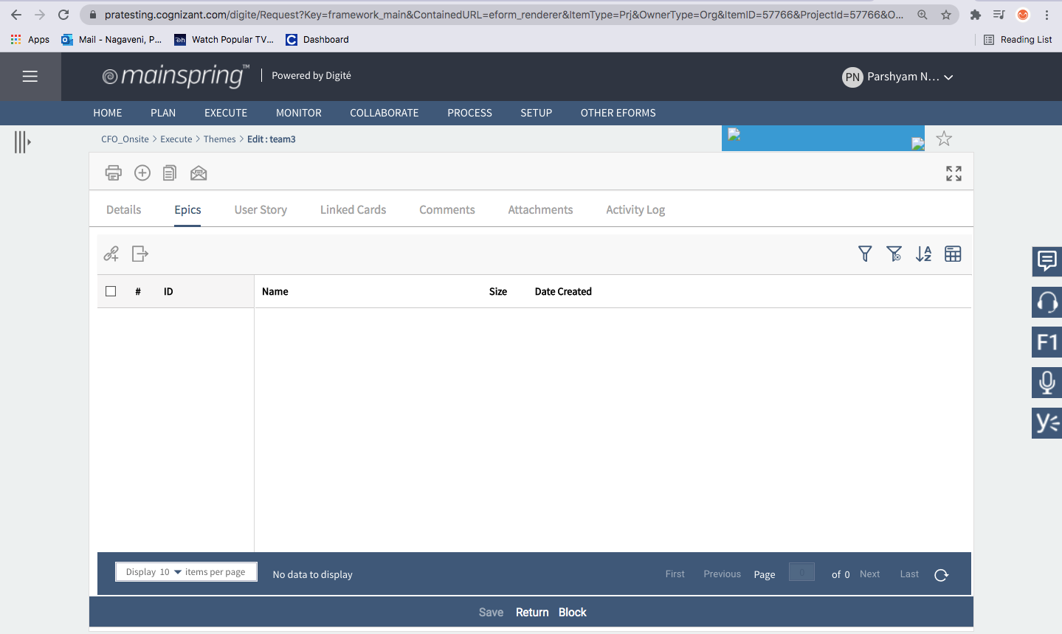
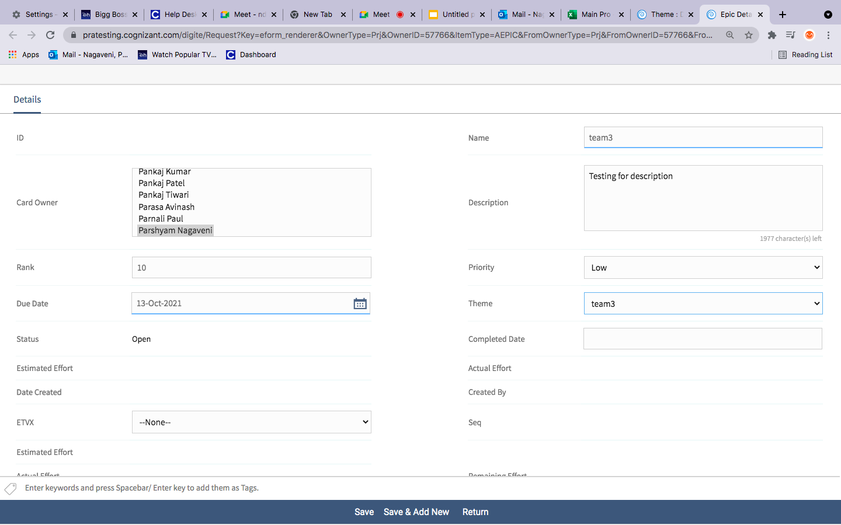
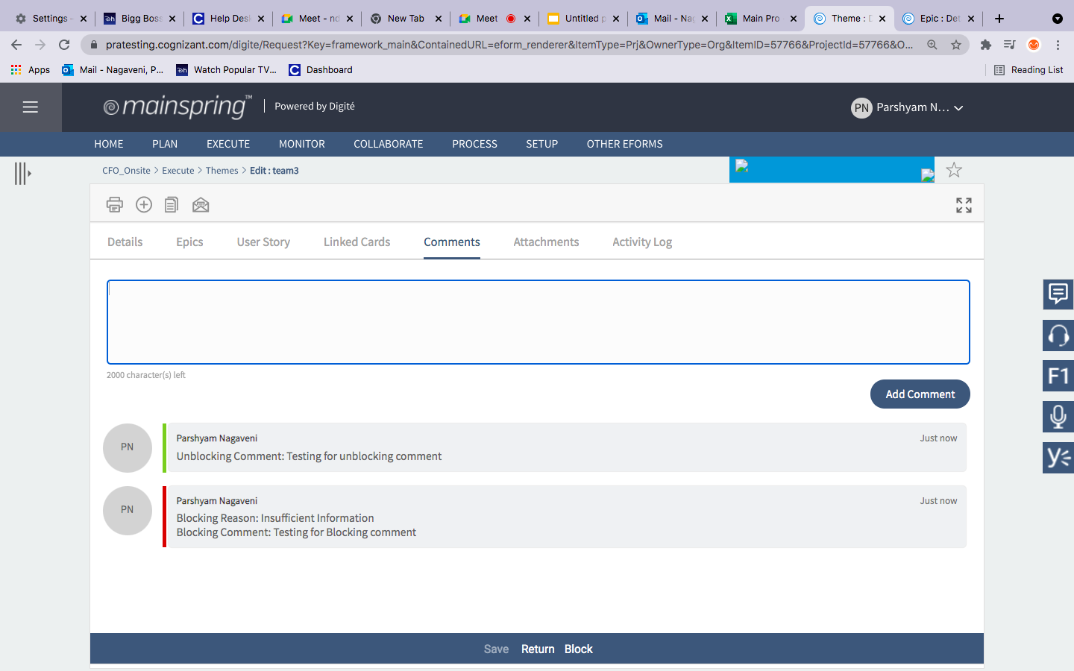
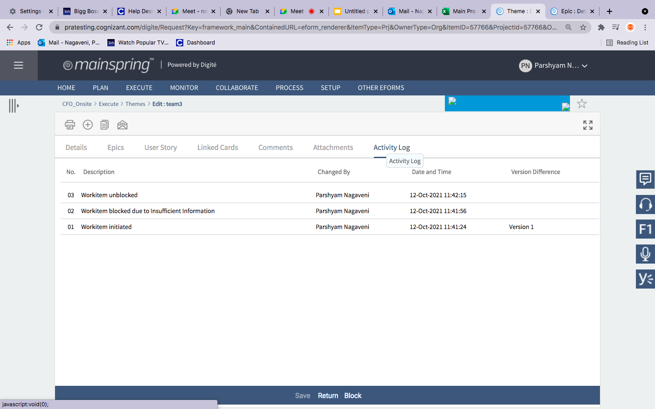
Screenshots of Output

Slide 9
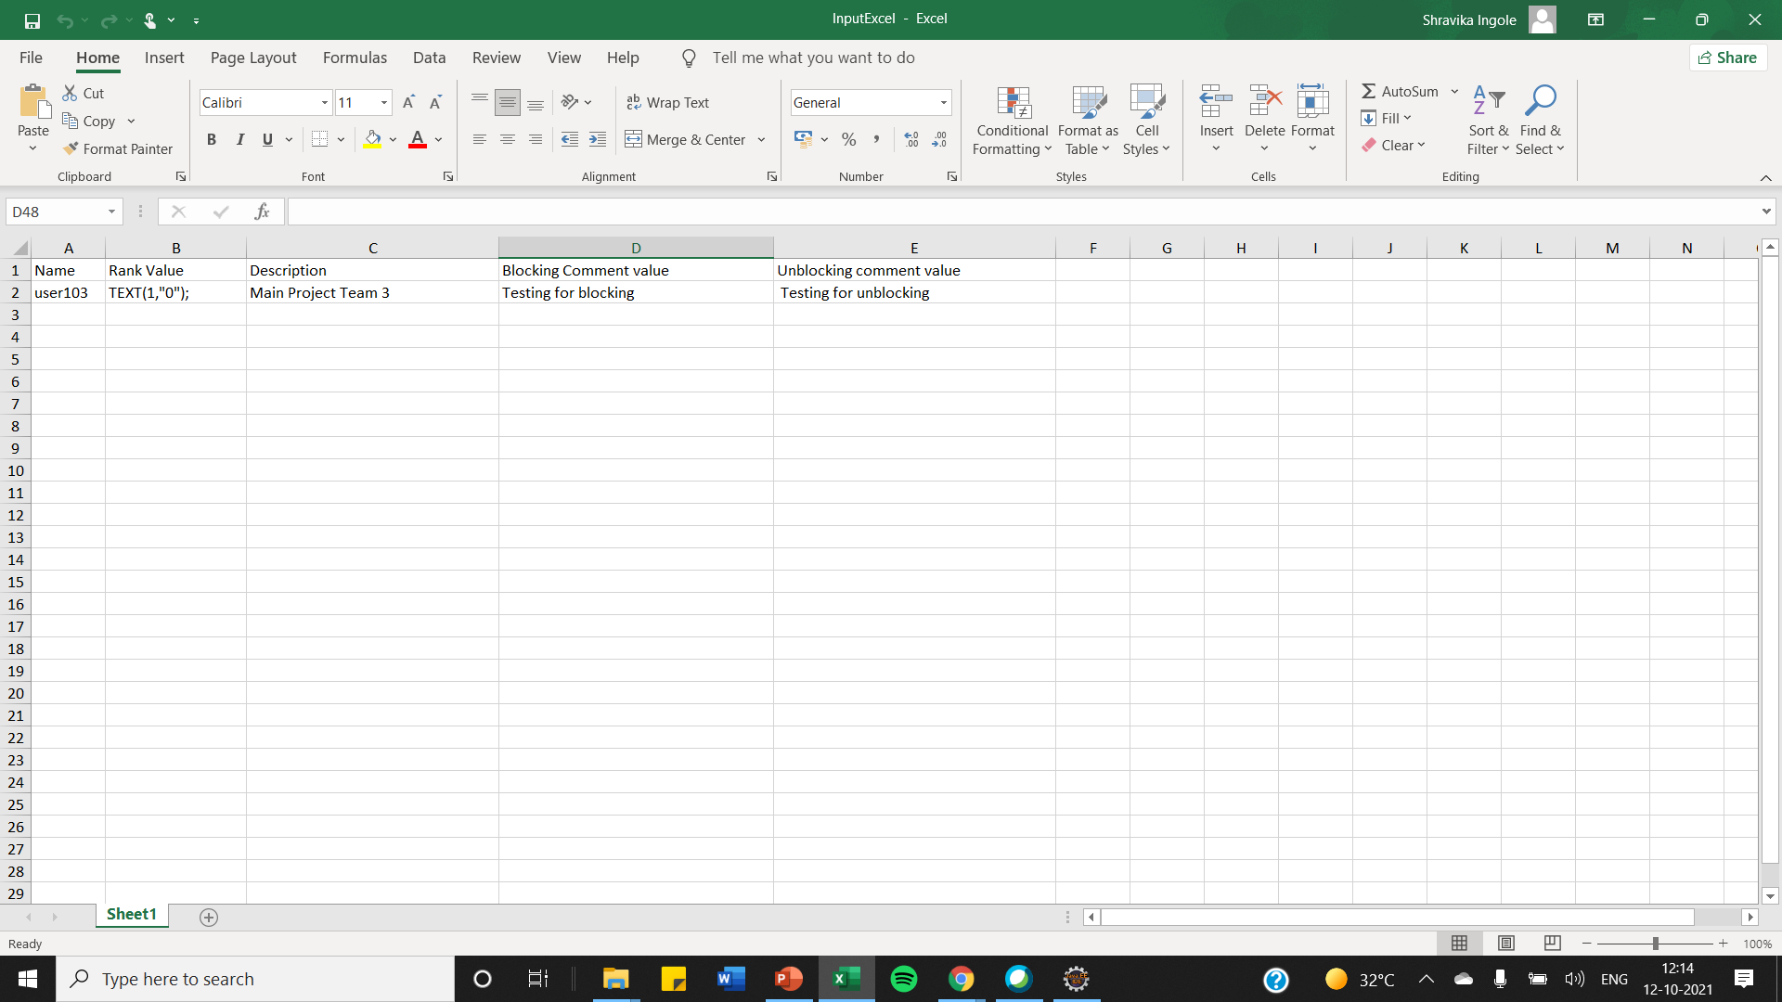
Excel Screenshots

Slide 10
Thank You

